Slide 1
Heart Disease Analysis
Created By
Rishikesh Surve

Slide 2
Table of Contents
Objective
Column Description
Data Description
Analysis and Results

Slide 3
Objective
The primary objective of this project is to conduct a comprehensive analysis of heart disease diagnostic factors using a dataset containing various patient features. The goal is to derive meaningful insights, identify potential risk factors, and contribute to the broader understanding of cardiovascular health.
The raw dataset comprises 1025 rows and 14 columns, with key variables including 'age', 'sex', 'cp', 'trestbps', 'chol', 'fbs', 'restecg', 'thalach', 'exang', 'oldpeak', 'slope', 'ca', 'thal', and 'target'. The definitions and significance of their low and high values are outlined below:
Objective

Slide 4
Column Description
Age: age in years
Sex: sex
1 = male
0 = female
CP: chest pain type
0: typical angina
1: atypical angina
2: non-anginal pain
3: asymptomatic
trestbps: resting blood pressure (in mm Hg on admission to the hospital)
chol: serum cholestoral in mg/dl
fbs: (fasting blood sugar > 120 mg/dl)
1 = true;
0 = false
restecg: resting electrocardiographic results
Value 0: normal
Value 1: having ST-T wave abnormality (T wave inversions and/or
ST elevation or depression of > 0.05 mV)
Value 2: showing probable or definite left ventricular hypertrophy by Estes' criteria
thalach: maximum heart rate achieved
exang: exercise induced angina
1 = yes
0 = no
oldpeak = ST depression induced by exercise relative to rest
slope: the slope of the peak exercise ST segment
Value 0: upsloping
Value 1: flat
Value 2: downsloping
ca: number of major vessels (0-3) colored by flourosopy
thal: 0 = Unknown
1 = fixed defect
2 = normal
3 = reversable defect
target (the lable): 0 = no disease,
1 = disease

Slide 5
Data Description
The raw dataset consists of 1025 records, each with 14 attributes. These attributes include patient demographics, clinical measurements, and results of medical tests.

Slide 6
Analysis and Results
The raw dataset consists of 1025 records, each with 14 attributes. These attributes include patient demographics, clinical measurements, and results of medical tests.

Slide 7
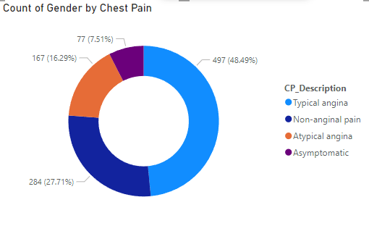
Count of Gender by Chest Pain
Typical Angina: The most common accounting for 48.49%, indicating it is often reported and linked to coronary artery disease.
Non-anginal Pain: Second most frequent at 27.71%, suggesting many patients experience chest pain from non-cardiac causes.
Atypical Angina: Represents 16.29%, with symptoms not typically associated with heart disease.
Asymptomatic: Least common at 7.51%, showing most patients with heart issues repot some form of chest pain.

Slide 8
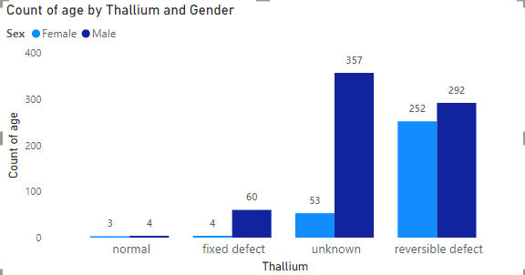
Count of Age by Thallium and Gender
Unknown Results: Males (357) greatly outnumber females (53).
Reversible Defect: Males (292) slightly surpass females (252).
Fixed Defect: Males (60) significantly exceed females (4).
Normal Results:
Rare for both genders: Males (4), Females (3).
Fixed Defect:
Higher in males (60) compared to females (4), indicating more non-reversible heart issues in males.
Reversible Defect:
Common in both genders but slightly higher in males (292) than females (252).

Slide 9
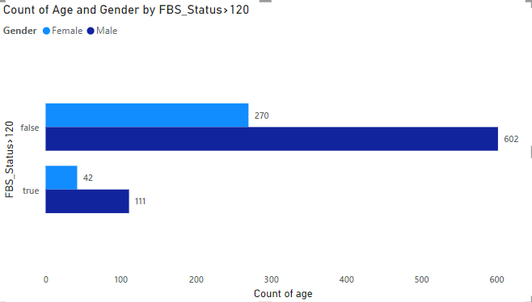
Count of Age and Gender by FBS_Status > 120
FBS<=120: Males (602) dominate this group, outnumbering females (270) by more than two to one.
FBS> 120: Again, males (111) outnumber females (42), showing a similar pattern of male predominance as seen in the FBS ≤ 120 group, although the disparity is less pronounced.
Males have higher counts in both FBS categories, indicating a higher prevalence of both normal and elevated FBS levels compared to females.

Slide 10
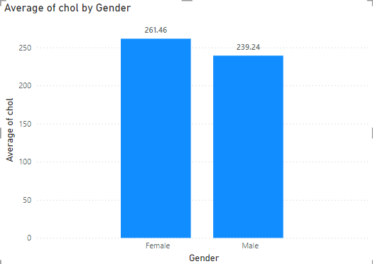
Average of Cholestrol Level by Gender
Females have a higher average of cholesterol levele (261.46 mg/dl) compared to males (239.24 mg/dl).
This suggests that females tend to have higher cholesterol levels on average

Slide 11
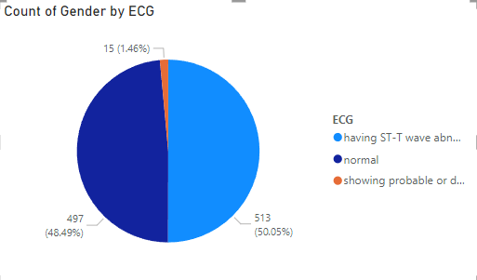
Count of Gender by ECG
Normal ECG(48.49%): A large segment with normal results suggests good heart health in nearly half of the population.
ST-T wave Abnormality (50.05%): The predominant finding points to a need for vigilant cardiovascular monitorinig and possibly more aggressive management and risk factors.
LVH (1.46%): though less common, it is a critical condition that requires specialized care.

Slide 12
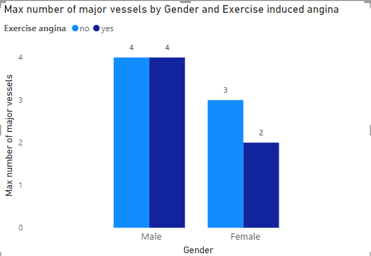
Major vessels by Gender and Exercise induced angina
In males maximum number of angina vessels is 4 regardless of exercise-induced angina (Yes/No).
In Females max number of angina vessels is 3 for exercise-induced angina (No) and 2 for exercise-induced angina (Yes)

Slide 13
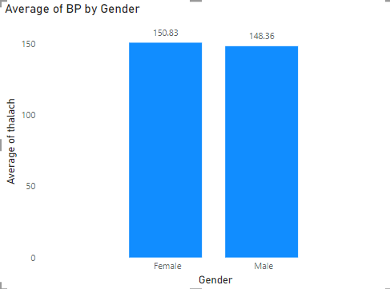
Average BP by Gender
The provided data indicates that the average blood pressure is slightly higher in females compared to males.
Males: The average BP is 148.36 mmHg.
Females: The average BP is 150.83 mmHg.
This suggests that, on average, females have a slightly higher blood pressure compared to males.

Slide 14
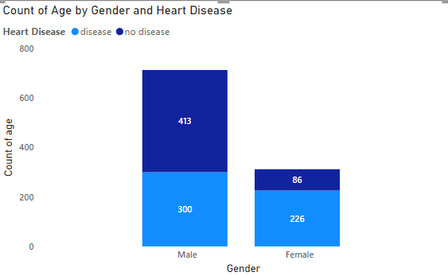
Age and Gender by Heart
Disease
We understand that a high proportion of males i.e. 58.04% have heart disease whereas in females it is 27.56%
In Females we see that the 72.44% majority of people do not have the disease and for males it is 41.96%.

Slide 15
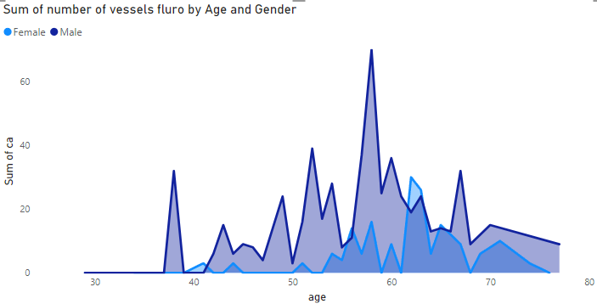
Vessels Fluro by Age and Gender
The graph shows the sum of the number of vessels by age and gender. The blue line represents female, and the dark blue line represents male. The graph indicates that the number of vessels is higher for males than for females in most age groups. The peak for males occurs at around 55 years old, while the peak for females occurs at around 65 years old. The graph suggests that the number of vessels increases with age for both genders, reaches a peak, and then declines as age increases.

Slide 16
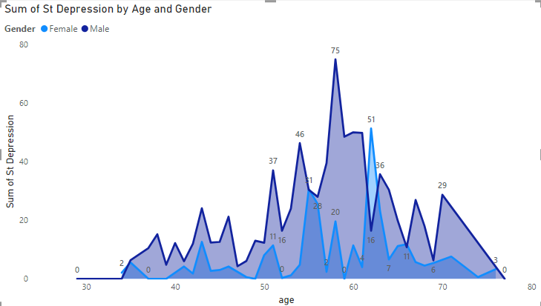
St Depression by Age and Gender
The graph shows the sum of depression by age and gender. The blue line represents females and the dark blue line represents males. The graph shows that females have a higher sum of depression than males in most age groups. The highest sum of depression for females is in the age group of 60-65, with a sum of 51. The highest sum of depression for males is in the age group of 55-60, with a sum of 75. The graph suggests that depression is more prevalent in females than males, and that the prevalence of depression increases with age for both genders.

